Slide 1
Budget
Byte
Eric Gerner, Kevin Adkins, David Abundis, Alvaro Gonzalez, Jorge Munoz

Slide 2
Introduction
This is the project that we will be working on throughout the semester
By the end of this presentation, we hope you’ll understand:
  What we’re doing
  What features we want to implement
  How we’re going to do it
  What we hope to achieve by the end of the semester

Slide 3
The problem
College students not receiving proper nutritious meals while working with a limited budget and in turn ingredients.

Slide 4
Our solution
An app that can take a picture of what you have and come up with a meal idea.

Slide 5
What will AI do?
Logo
Image Analyzer
Meal Suggestions
Generate Recipes
Computer Vision to classify ingredients
One photo of multiple ingredients
Scan labels to retrieve information
Feed an LLM with the ingredients and suggest what can be made
Provide users with step by step instructions
Take into account the cooking method available ie a stove, oven or microwave.

Slide 6
Why it’s the right tool?
Computer vision is the right solution for ingredient detection because we need to identify and classify multiple ingredients within a single image frame.
When ingredients are already combined in a dish, image segmentation allows us to isolate and analyze individual components more accurately.
Rather than relying on a static recipe database, we can leverage a Large Language Model (LLM) trained on food related data to dynamically generate meal ideas based on detected ingredients.
However, for precise nutritional analysis, AI-generated estimates may introduce inaccuracies. To ensure reliability, integrating a trusted nutrition API is the best practice.

Slide 7
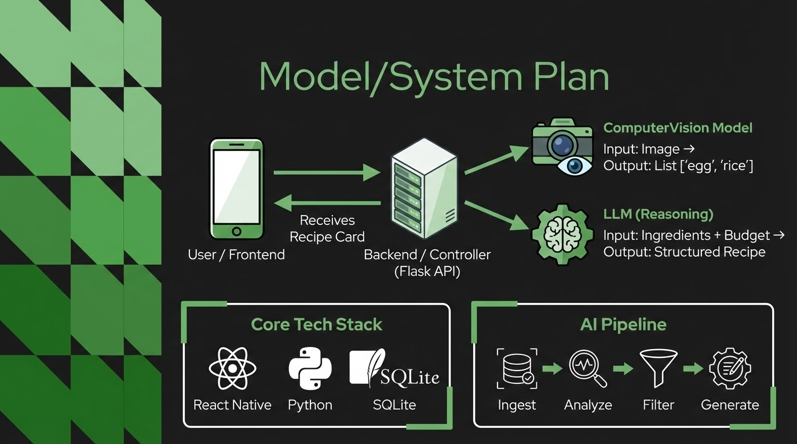
Notes:
Our system is built on a Flask architecture. When a user snaps a photo, it travels to our backend where we route it through a two-step AI process. First, the Computer Vision model identifies the raw ingredients. Then, we pass that data to an LLM which acts as the 'Chef,' strictly constrained to generate budget-friendly recipes. We use SQLite to cache these results, so if a user scans the same ingredients again, we don't have to pay for another API call.

Slide 8
Data Plan (What data? How collected? Privacy?)
What Data?
User takes images of fridge/pantry items
Dietary restrictions, Cooking equipment, and budget.
Recipes, Ingredient lists, and cost/time estimate by the AI
How it’s Collected?
Images are captured and sent to the Backend
Computer Vision extracts data from the image
Store the text in our SQLite database.
Privacy & Ethics
"We only store what we need." By deleting the actual photos after processing, we avoid accidentally storing sensitive info
(like a family photo in the background of a fridge picture).
Users can clear their search history/saved recipes from the local database at any time.
Notes:
For our Data Plan, we prioritized user privacy and low overhead. We collect images of food, but we process them 'temporarily.' This means once our computer vision model identifies the ingredients, the image is deleted. We only store the text data in our SQLite database. This keeps our storage costs low and ensures that if a user accidentally takes a photo of something private, it isn't saved on our servers.

Slide 9
MVP Scope
These are what we plan on having being demoed by April 5th:
Detect items from a fridge, whether by photo or in-person
Sort items into possible meals or options which can be made into meals
Ensure that all food can be made into meals; if not, then disposed of
Keeping in mind the budget friendly meals as our basis for AI suggestion

Slide 10
Risk and Ethics
1
Misuse of app/AI for not its intended purpose. Taking picture of things that are not food
3
Bias in the AI on what types of meal it generates. We do not want the meals to be for one specific demographic
2
Data exposure can expose sensitive information with the picture you take. Only store relevant data
4
Hallucinations like the CV seeing the wrong ingredients. Food safety proper cooking temperatures and not eating expired food

Slide 11
Success Metrics & Evaluation Plan
On Time
Track Progress
Sprints
Have an MVP by Milestone 2
We are using Jira to track our tasks as a team
How we will stay on track and hold each other accountable
Use sprints to track progress and stay on track
Evaluation Plan
Team meetings to discuss performance and areas for improvements.
Month Year

Slide 12

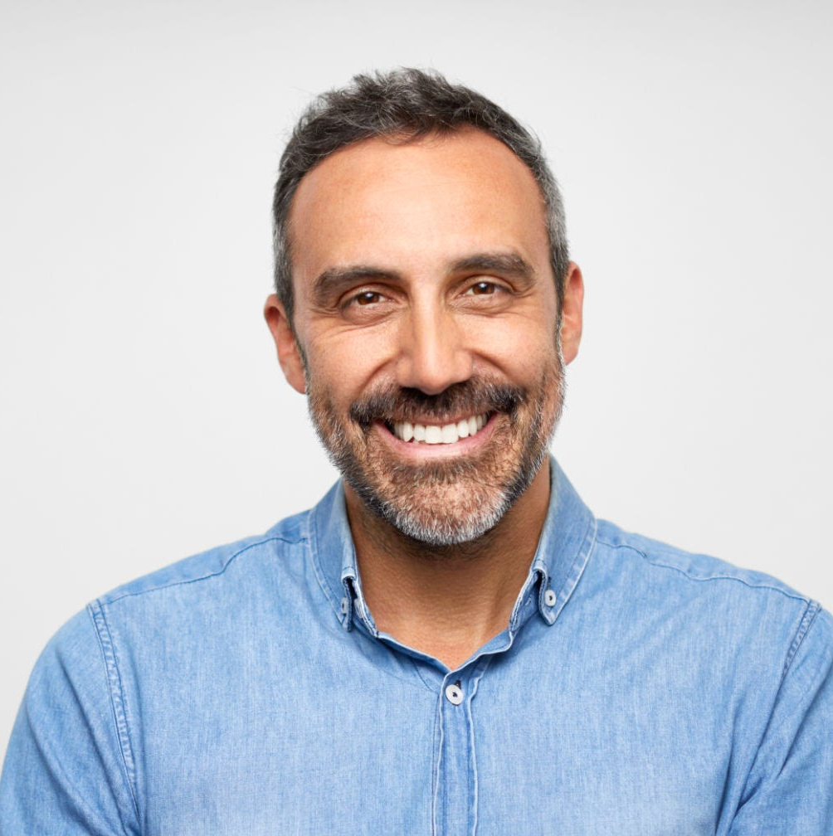
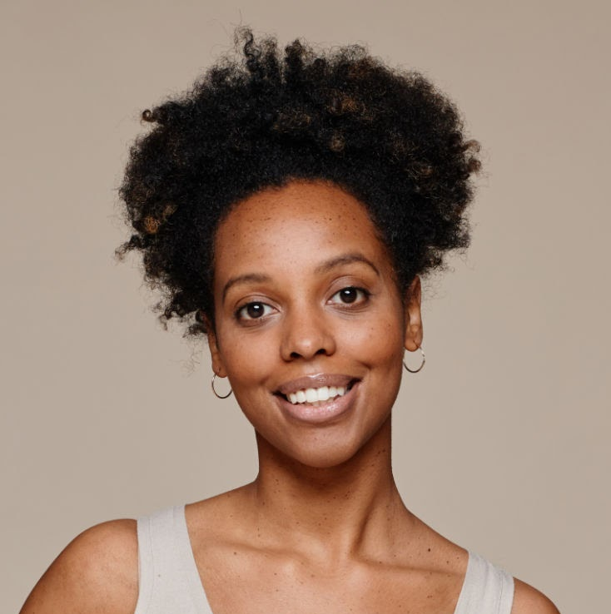

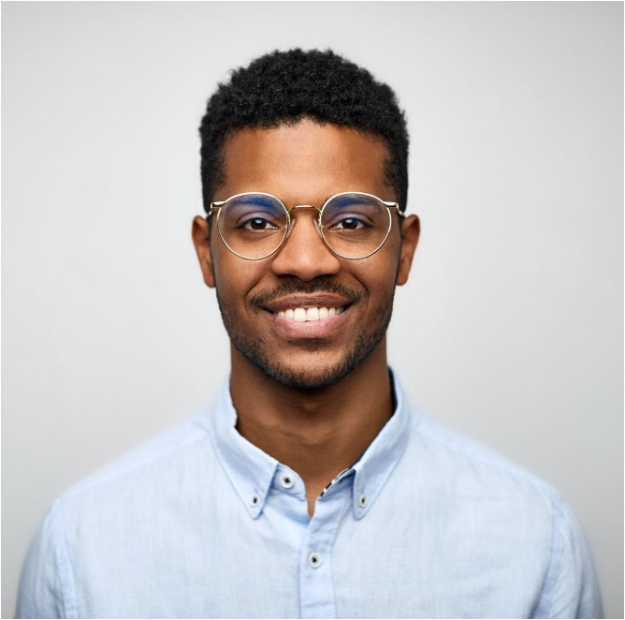
Roles
Jorge Munoz
Kevin Adkins
Alvaro Gonzalez
David Abundis
Eric Gerner
Team Leader; AI developer
Frontend developer
Database developer
Wireframe developer
Backend developer

